Slide 1

My smart rome (FINAL STEP)
Project Team:
-Daniele Ottaviani
-Daniele Pasquini
-Davide Francesconi

Slide 2



Final (?) ux
CHAT YES OR NOT? HISTORY POSITIONS YES OR NOT?

Slide 3


«no history, NO CHAT, but…»
ALTERNATIVE IDEA FOR COMMUNICATION :
BUSINESS CLIENT

Slide 4





Business client

Slide 5


BUT COMMUNICATION BY ?
SOLUTION 1 : by App,
new home interface ,
two login (one tourist, one business client)
SOLUTION 2 : by web site ,
only one interface for business login

Slide 6
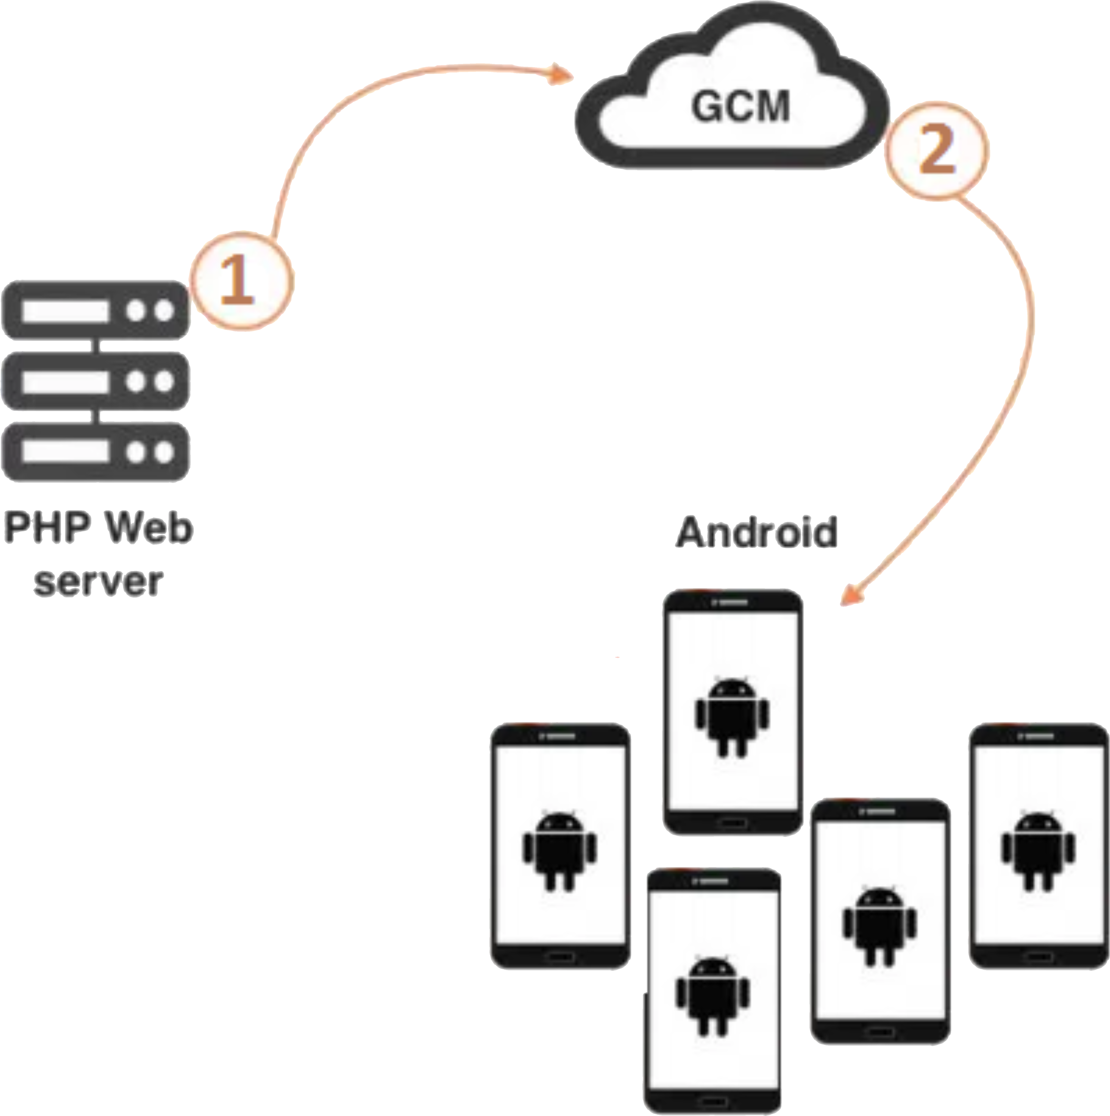
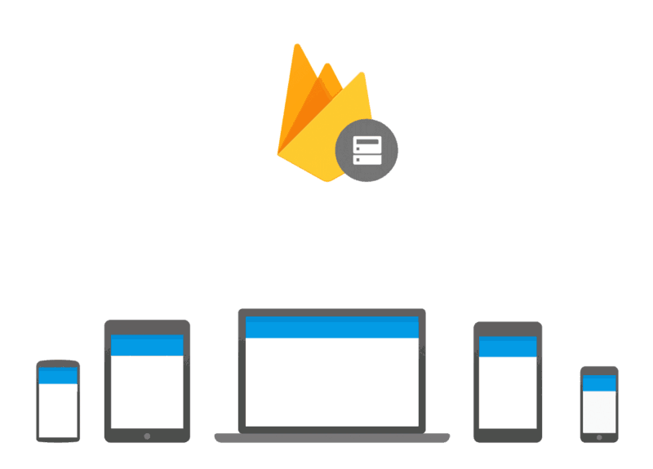
Ux - Best Solution 2° : by web site

Slide 7



Business client to tourists
BUSINESS CLIENT SEND PUSH NOTIFICATION TO USERS OF MY
SMART ROME, WITH THEIR POSITION AND THEIR MESSAGE.

Slide 8

my smart rome [Final version]
SUPPORT TO TOURISM
(LIVE POSITION, ATTRACTIONS POSITION)
SUPPORT TO ROME BUSINESS
( PROMOS, OFFERS, SALES ARE COMMUNICATED TO TOURISTS)

